Slide 1
Project Skyline
Building an open-source, consumer-facing, user interface for Triton DataCenter
Notes:
Hello. We are Project Skyline, and we are building an open-source, consumer-facing, user interface for the Triton DataCenter cloud management platform. (~10 seconds)

Slide 2
Group Members & Project Advisor
Group Members:
Matt Osbourne - osbourma@mail.uc.edu
Spencer Dangel - dangelsc@mail.uc.edu
Alec Reser - reserad@mail.uc.edu
Project Advisor
Patrick Olekas - olekaspt@mail.uc.edu
Notes:
My name is Matt Osbourne, and on this project I am joined by Spencer Dangel and Alec Reser. Our project advisor is Patrick Olekas. (~10 seconds)

Slide 3
Goals
Create and implement a new user interface for Triton DataCenter.
Learn new technologies
Integration and Unit testing with at least 80% code coverage
Notes:
As we have said before, the end goal for our project is to have a fully functioning user interface for Triton DataCenter, that allows a consumer, or user to add, delete, save and configure virtual machines as desired, without requiring the help of a customer service representative.
One of the side goals of our project is to learn a new technology or two along the way. We are using Typescript for the backend, but it is basically NodeJS with types. We are comfortable in NodeJS, but wanted to have the experience of static typing on the backend as well as the frontend. On the frontend, we decided to go with an entirely new framework, where we are using React with Redux. We are all comfortable in AngularJS and felt that it would be beneficial to use this project as an opportunity to learn something new.
Another side goal for this project was to implement unit and integration testing with at least 80% code coverage. The reason we chose to use Jest is because we have read about it’s easy setup and use for unit and integration testing. None of us have any real experience adequately testing projects we have worked on in the past because deadlines have come in the way, and we believe this will be good time to experiment with unit and integration testing. (~1:10)

Slide 4
Intellectual Merits
There is no frontend for Triton that currently exists for non-technical users
Notes:
Triton can be somewhat described as a competitor to Digital Ocean, where a company, organization, or a single person can deploy a cloud computing platform, privately, on their own hardware. We are making a frontend that allows a company to deploy a public cloud interface that is accessible to non-technical users. Currently, the only frontend application that Triton has available is only meant to be used by the person or organization that owns the hardware, and it isn’t exactly user-friendly for a non-technical user either. (~30 seconds)

Slide 5
Broader Impacts
Make hosting public cloud services more accessible
Make creating, using, and editing a virtual machine more user friendly
Notes:
This project, like many software projects, isn’t going to do anything groundbreaking in terms of impacting human society.
We aren’t reinventing the wheel here, but we are attempting to making hosting your own public or private cloud easier and more user friendly for non-technical users.
The use case for our software is: A company or person could build and deploy their own hardware running Triton DataCenter as well as our finished application, and be able to offer virtual machines at lower prices than their big name competitors (Digital Ocean is a good example). It is worth noting here that we are only tackling the problem of having a frontend for Triton DataCenter, we aren’t building our own payment gateway for this project, as that would be enough work for a separate senior design project on it’s own. (~45 seconds)

Slide 6
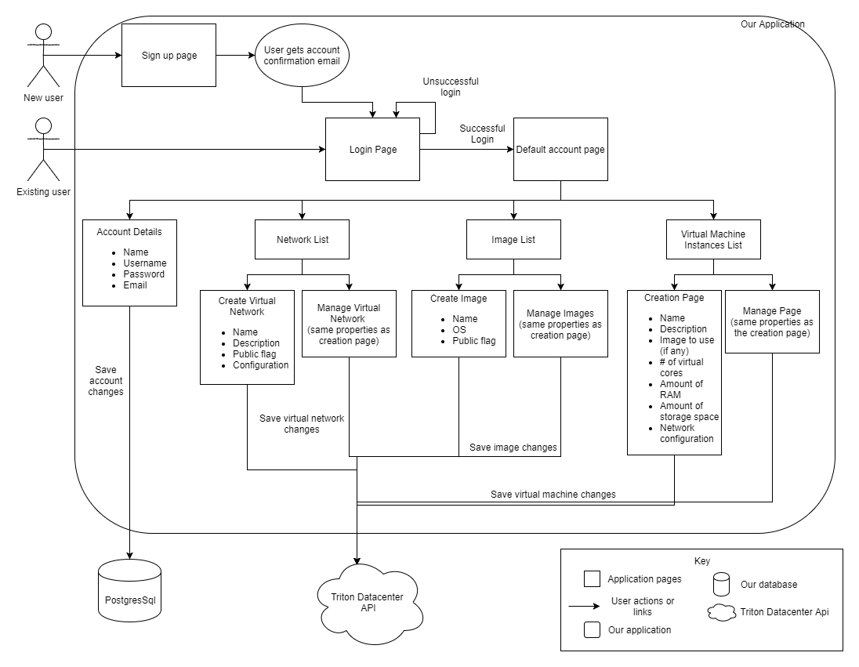
Design Specifications
Notes:
The image shown here is that of our most detailed design diagram. A new user will start by reaching the signup page, and when they have entered the required information, they will be sent an account creation confirmation email and will be directed to the login page. From there, an existing user will enter their login details; if their information is incorrect, they will stay on the login page, and if it is correct they will be redirected to the default account page. On the default account page, a user will be able to edit their account details, such as name, username, password, and email, as well as access their network list, virtual machine image list, and virtual machine instances list. In the network list section, a user will be able to create or edit the name, description, public flag, and configuration of their virtual networks. In the virtual machine image section, a user will be able to create or edit the name, operating system, and public flag of their virtual machine images. In the virtual machine instances list section, a user will be able to create or edit the name, description, image (if they have any preconfigured in the virtual machine images section), number of virtual cores, amount of RAM, amount of storage space, and the network configuration of a virtual machine instance. The changes made on this page that relate to the account details will save to a PostgreSQL database, and the changes made that relate to virtual machines and virtual networks will be sent to the Triton DataCenter API. (~1:30)

Slide 7
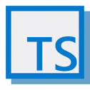
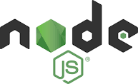




Technologies
Backend
NodeJS + Typescript
Jest
Frontend
ReactJS + Redux
Database
PostgreSQL
Knex + ObjectionJS
Notes:
We are using three main technologies in our project. The backend is being written in Typescript, the front end is being built in ReactJs with Redux, and we are using a PostgreSQL database to store data. We chose these technologies for two reasons:
1- we wanted to learn some new frameworks and languages if we could,
2 - they all run on unix systems, and
3 - using Typescript on both the backend and the frontend makes it easier to switch between the backend and frontend projects because the language is the same (~30 seconds)

Slide 8
Milestones
Finish administration work related to the project assigned in the course - we are almost finished with this
Create initial backend server - this is done
Create initial frontend application - this is done
Add integration to Triton - This is in progress
Create CRUD pages for VMs - This is to be done by 3/21
Unit and Integration testing - This is to be done by 4/1
Frontend styling - This is to be done by 4/1
Notes:
In terms of milestones, we are roughly half way through. The first milestone that we wanted to get out of the way is to finish all the administration work required in this class so we can simply buckle down and finish our actual project. We have finished our rough draft of our poster, and after that is finalized, we are done with everything extra besides our software related milestones. Our second and third milestones are to actually create the frontend and backend applications that we will be building our project onto. We currently have a running frontend application built in React with Redux, and we currently have a running backend server running on Typescript. Those milestones are done. What we are currently working on is the server integrations to Triton, which we expect to have finished in the next week or so. The next milestone will be to actually create the pages where a user can edit their profile, virtual machine images, virtual machine instances, and virtual networks; which we plan to have done by March 21st (two weeks before the expo). After the pages and integration are done, we will then focus on unit and integration testing for anything that we have not yet built along the way, and then focus on styling the frontend so that it is appealing to look at and easy for a user to use. We plan to have those last two milestones done a few days before the expo (on April 1st) so that we have a little bit of time to simply focus on cleaning up anything we need to fix before presenting our final project at the expo. (~1:30)

Slide 9
Results
Finished:
Almost all of the administration work for this project
Create initial backend server
Create initial frontend application
Next steps:
Finishing the integration to Triton
Building the CRUD pages for VMs
Notes:
As mentioned on the previous slide, we have finished almost all of the administration work for this project. In addition to that, we currently have working frontend and backend applications that we are going to build on top of to finish our project. We are currently working on finishing our backend integration to Triton, and when that is done, we will focus on building the frontend pages that will be used with the Triton integration to actually configure, deploy, and edit virtual machines and virtual networks. (~30 seconds)

